Slide 1

Segunda prueba Trabajo de investigación
Jose Emilio Labra Gayo

Slide 2

Creación de subconjuntos de grafos de conocimiento mediante Shape Expressions
Jose Emilio Labra Gayo

Slide 3
Razones para elección del tema
Continúa investigación sobre Shape Expressions y sus aplicaciones
Resolver problema práctico, propuesto por la comunidad
Participación en biohackathones con esa temática
Virtual Biohackathon 2020
SWAT4(HC)LS Hackathon 2021
Adopción de Shape Expressions por Wikidata
Contrato "Robustifying Scholia", Univ. Virginia, Sloan Foundation
Interés de Andra Waagmeester y proyecto GeneWiki
Parte de entregable proyecto ANGLIRU
Avance en la disciplina: Mejorar/facilitar consumo de datos semánticos

Slide 4
Principales resultados del artículo
Definición formal de grafos RDF, property graphs y wikibase graphs
Extensión de ShEx para property graphs (PShEx)
Extensión de ShEx para wikibase graphs (WShEx)
Definición de 5 técnicas de generación de subconjuntos
Entity-matching
Simple matching
ShEx-based matching
Shex+Slurp
ShEx+Pregel
Definición e implementación algoritmo validación a gran escala sobre Spark GraphX

Slide 5

Formato del trabajo
Artículo científico en inglés
La convocatoria no indica requisitos de idioma
El inglés permite su posterior presentación en revista/congreso
Publicado en abierto como preprint en Arxiv
https://arxiv.org/abs/2110.11709
Objetivos a corto plazo:
Optimizar implementaciones
Terminar experimentos
Enviar a publicación

Slide 6
Creating Knowledge Graphs subsets using Shape Expressions
Jose Emilio Labra Gayo

Slide 7
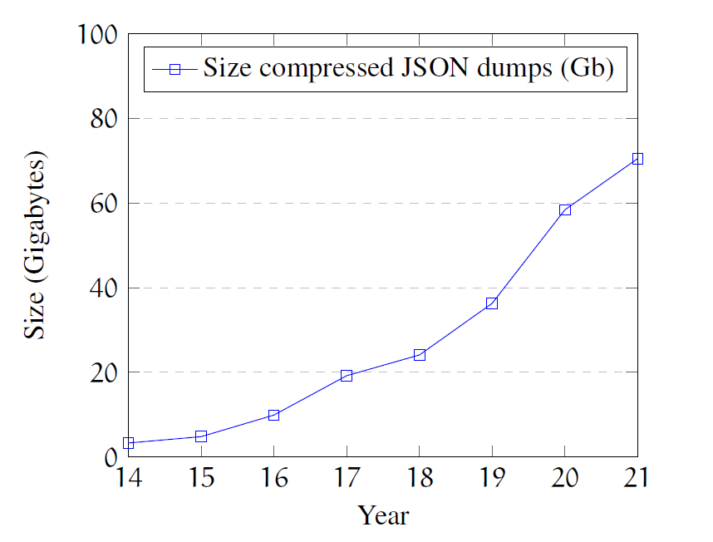

Motivation and main idea (1)
Since its proposal in 2012, KGs are very successful
Different kinds of KGs
Free/open and collaborative like Wikidata
Enterprise/proprietary and owned by companies: Google, Amazon, eBay, Facebook,Microsoft,...
Size of their contents is continually growing
Problem: KGs victims of their own success?
Example: size of Wikidata dumps almost doubling
30GB (2014 - uncompressed)
1.256GB (2021 - uncompressed)
Difficult for produce/consume/handle KGs
Idea 1: create subsets of KGs for some domain

Slide 8
Motivation and main idea (2)
<Researcher> {
:name xsd:string ;
:birthDate xsd:date ? ;
:birthPlace @<Place> ? ;
:knows @<Researcher> *
}
<Place> {
:name xsd:string ;
:country @<Country>
}
<Country> {
:name xsd:string ;
}
Shape Expressions: language to describe and validate RDF
Concise and human-friendly
Automatically processable
Several tools already exist around ShEx
Target audience: domain data experts
Already adopted by Wikidata to validate RDF serialization of Wikibase entities
Example of a ShEx schema
Idea 2: use Shape expressions to define those subsets

Slide 9
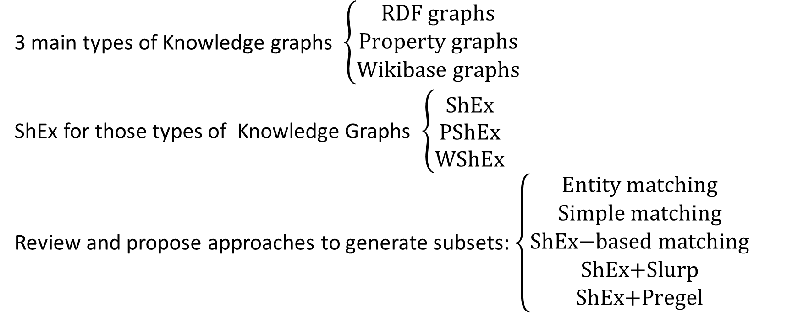
Structure of the presentation
3 main types of Knowledge graphs $\left\{\begin{aligned}\text{RDF} \text{graphs} \\ \text{P}\text{roperty} \text{graphs} \\ \text{Wikibase} \text{graphs}\end{aligned}\right.$
ShEx for those types of Knowledge Graphs $\left\{\begin{aligned}\text{ShEx} \\ \text{PShEx} \\ \text{WShEx} \end{aligned}\right.$
Review and propose approaches to generate subsets: $\left\{\begin{aligned}\text{Entity} \text{matching} \\ \text{Simple} \text{matching} \\ \text{ShEx}\text{−}\text{based} \text{matching} \\ \text{ShEx}\text{+}\text{Slurp} \\ \text{ShEx}\text{+}\text{Pregel}\end{aligned}\right.$

Slide 10
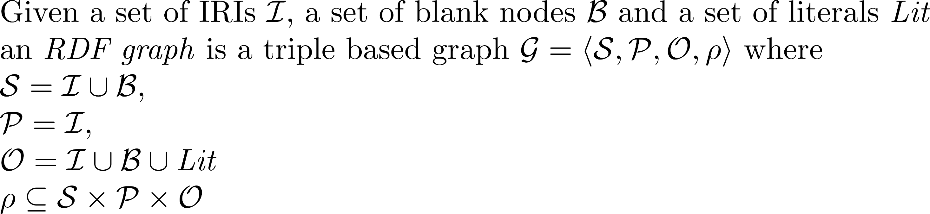
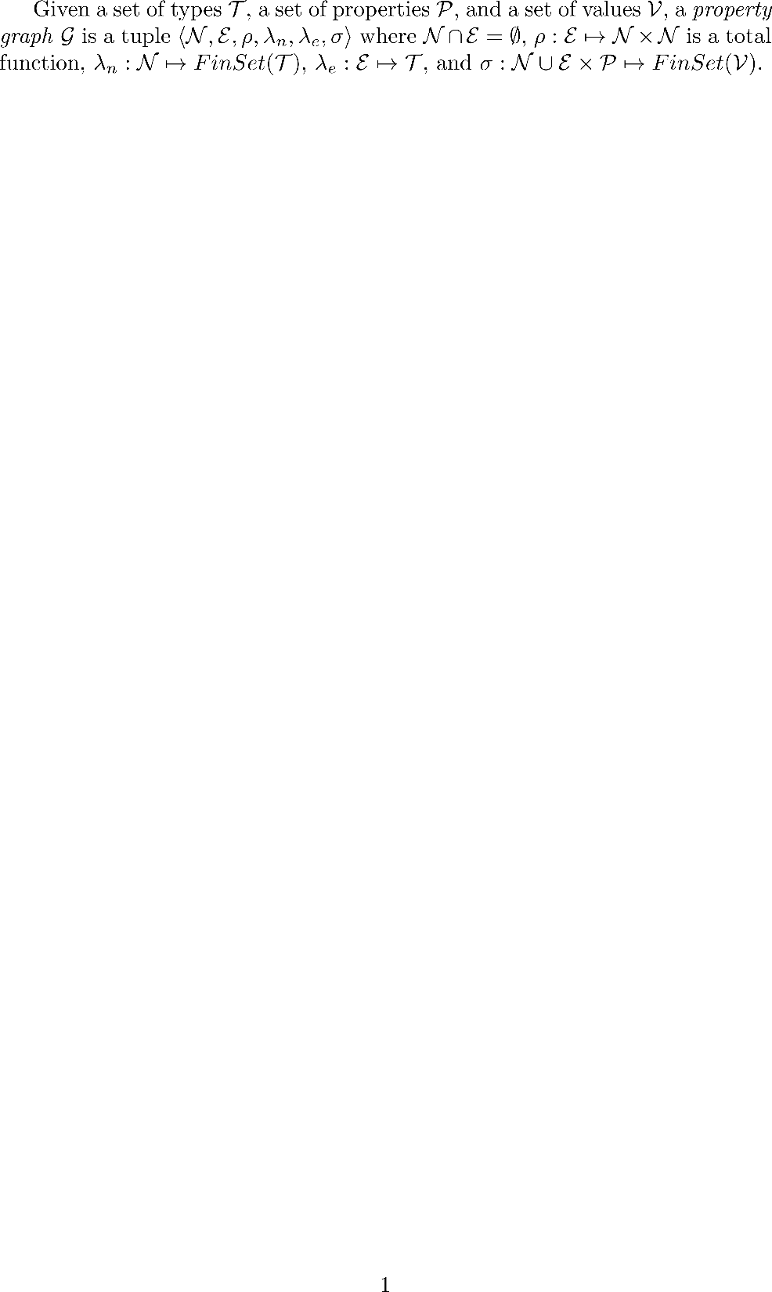
RDF graphs
:City
:Metropolis
rdf:type
rdf:type
:London
:country
:Human
:birthPlace
rdf:type
"Tim Berners-Lee"
:UK
:TimBL
rdfs:label
:knows
:birthDate
"1955-06-08"^^xsd:date
:Organization
:birthPlace
:employer
rdf:type
:Spain
:CERN

Slide 11
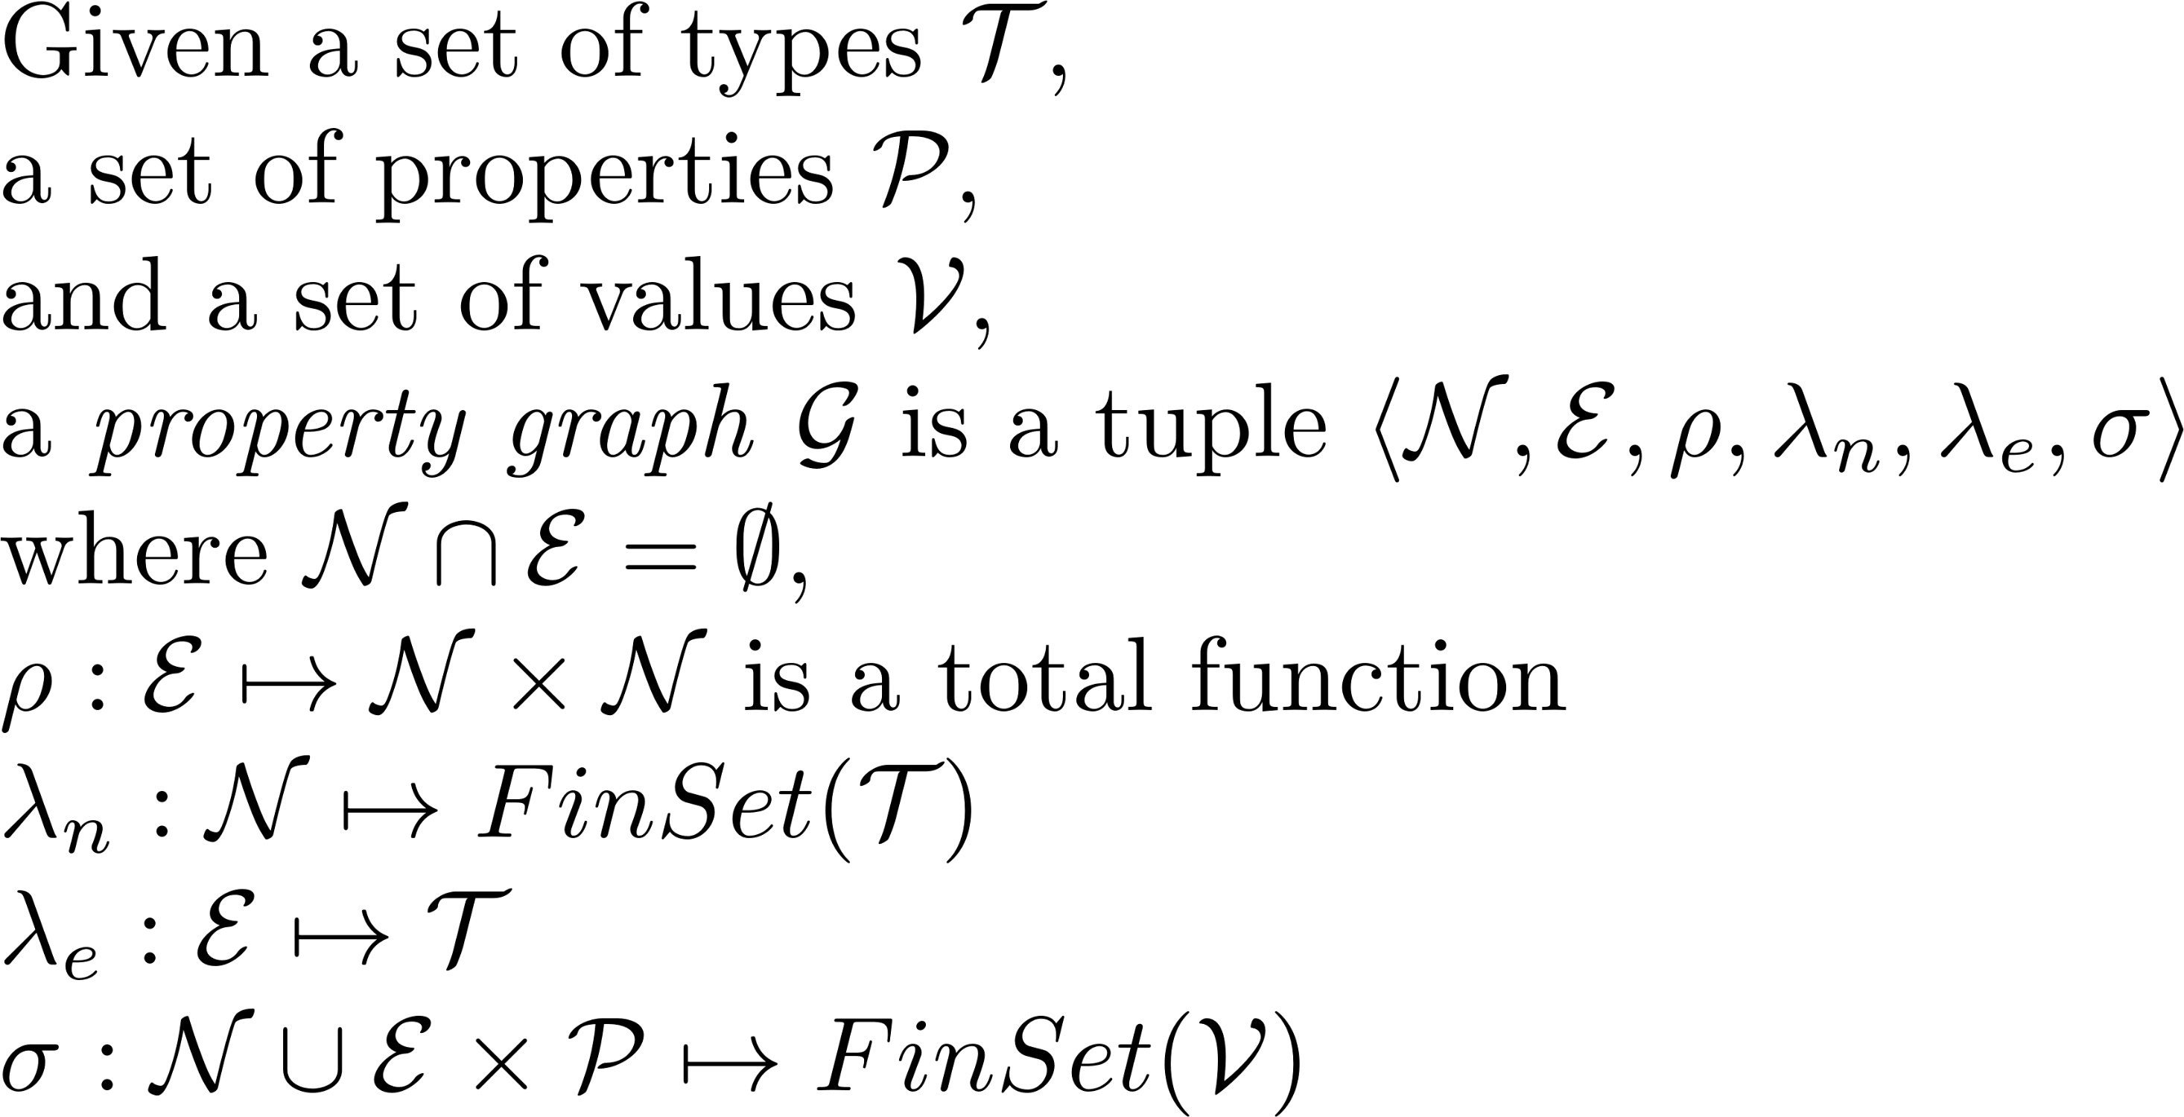
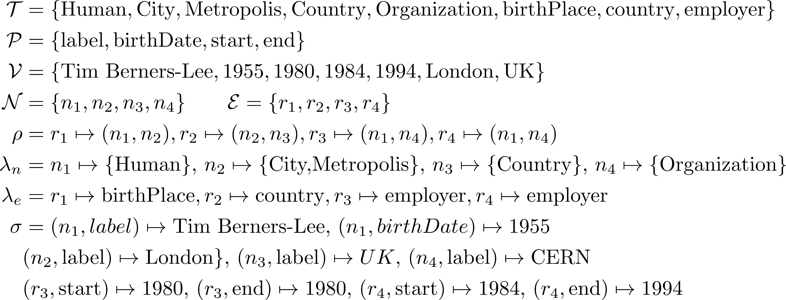
Property graphs
City, Metropolis
label: London
birthPlace
country
n₂
r₁
r₂
Country
label: UK
Human
r₃
n₃
label: Tim Berners-Lee
birthDate: 1955
n₁
employer
start: 1980
end: 1980
n₄
r₄
Organization
employer
label: CERN
start: 1984
end: 1994

Slide 12
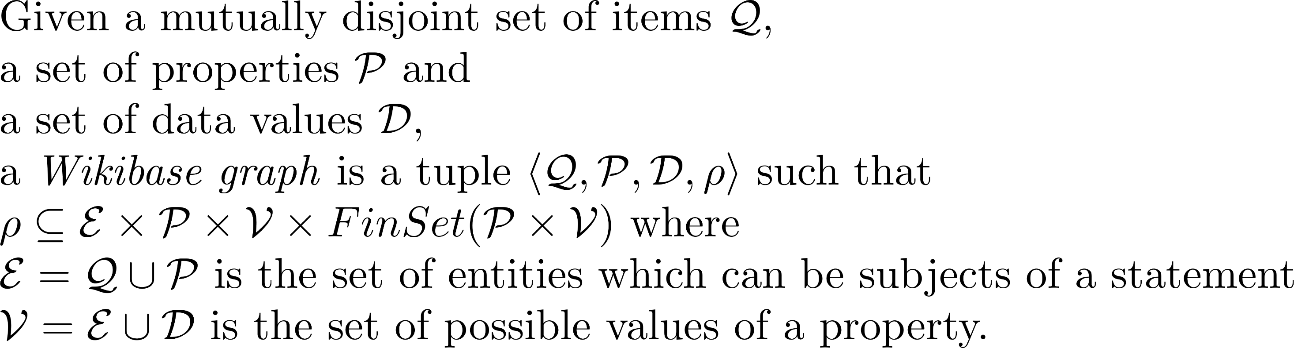
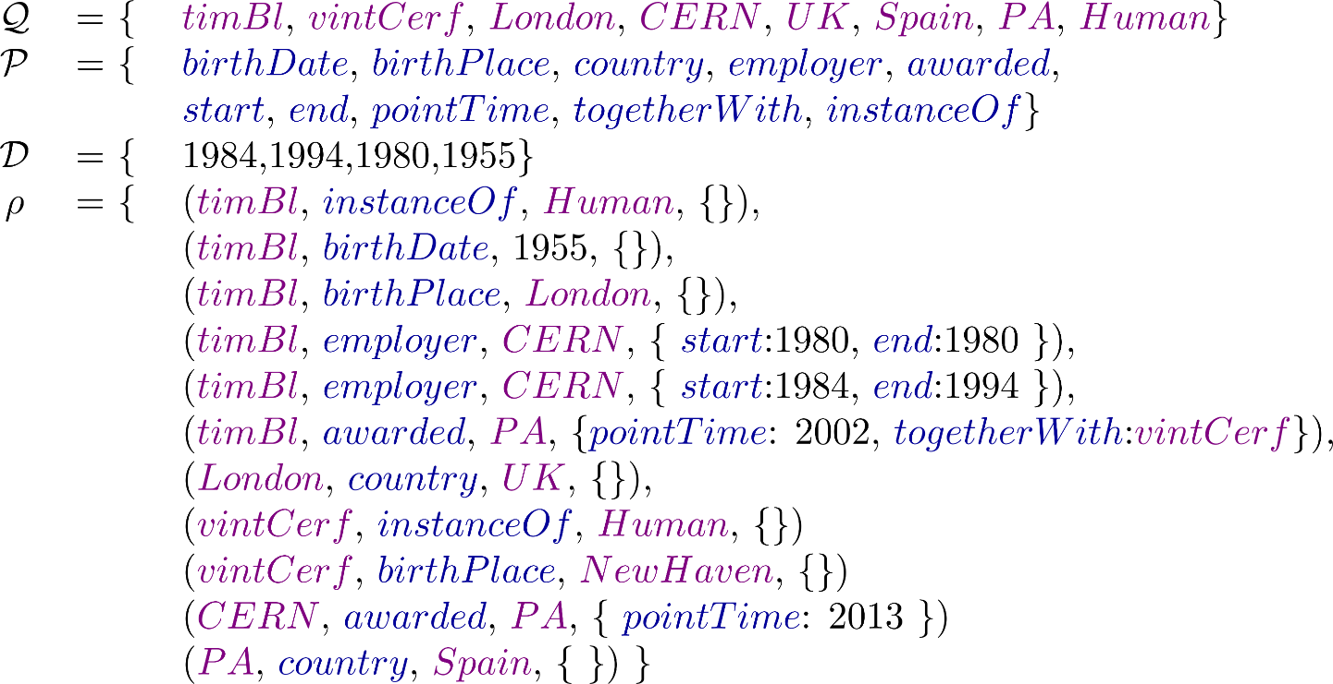
Wikibase graphs
country
UK
London
birthPlace
CERN
employer
- start: 1980
- end: 1980
employer
- start: 1984
- end: 1994
awarded
- pointTime: 2013
timBl
birthDate: 1955
awarded
- pointTime: 2002
- togetherWith:
instanceOf
Human
PA
country
Spain
instanceOf
vintCerf
birthPlace
NewHaven

Slide 13
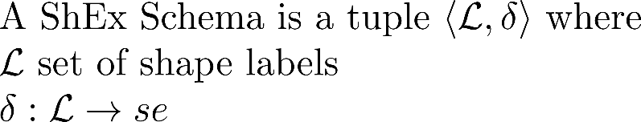
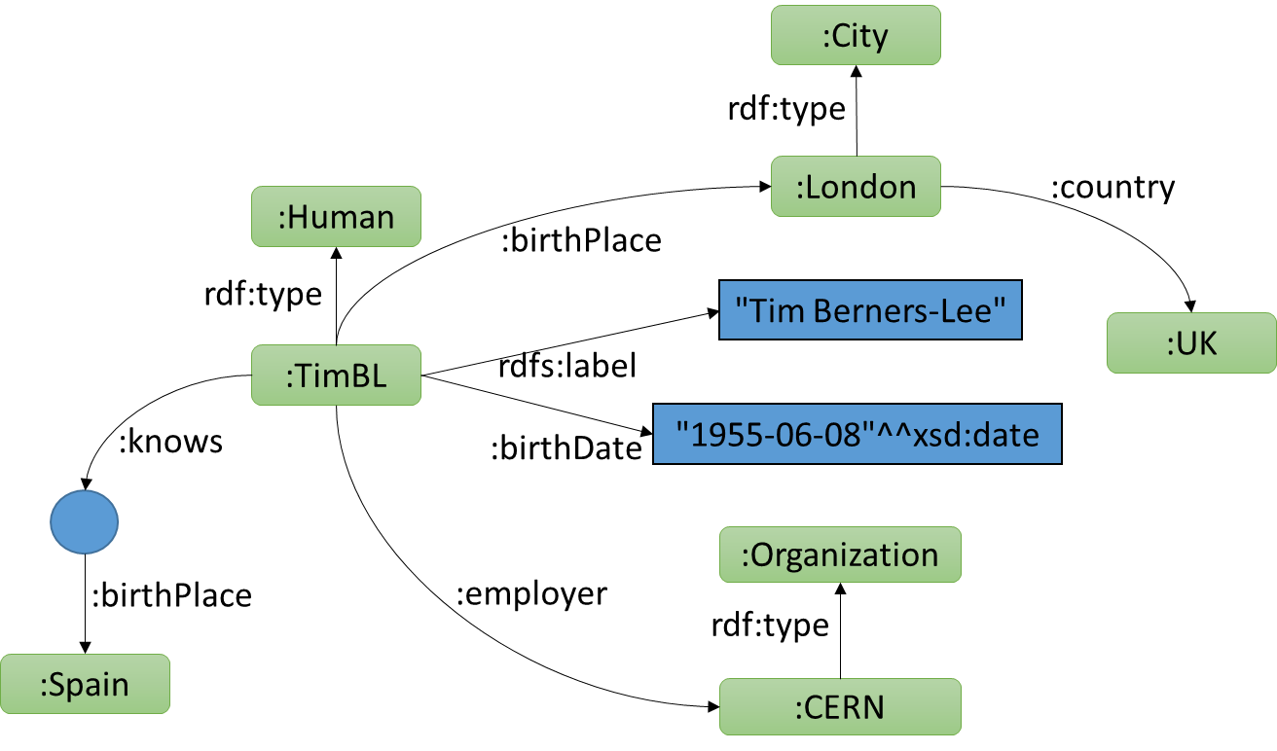
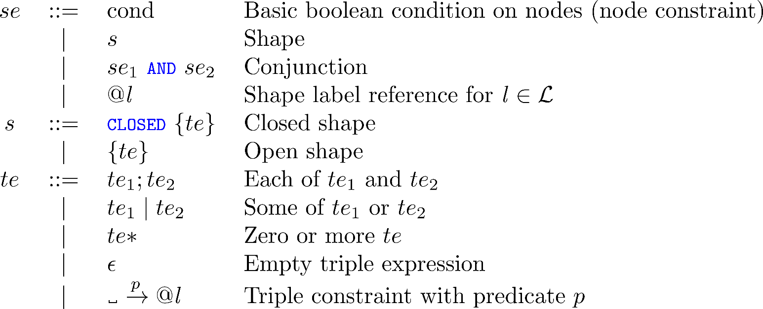
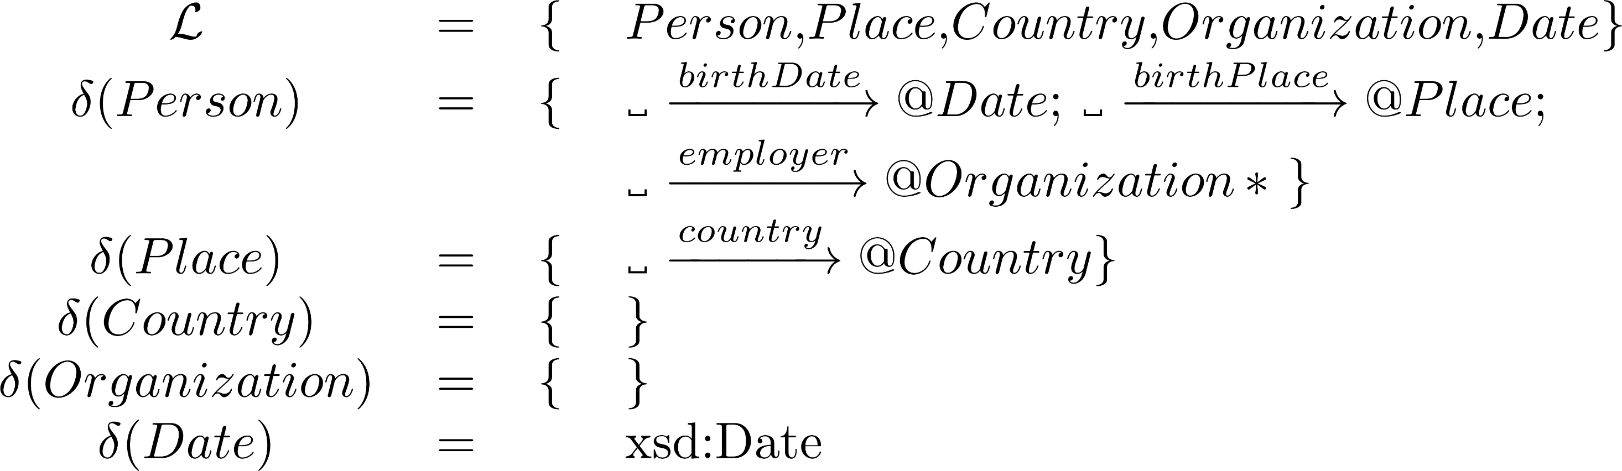
ShEx for RDF

Slide 14
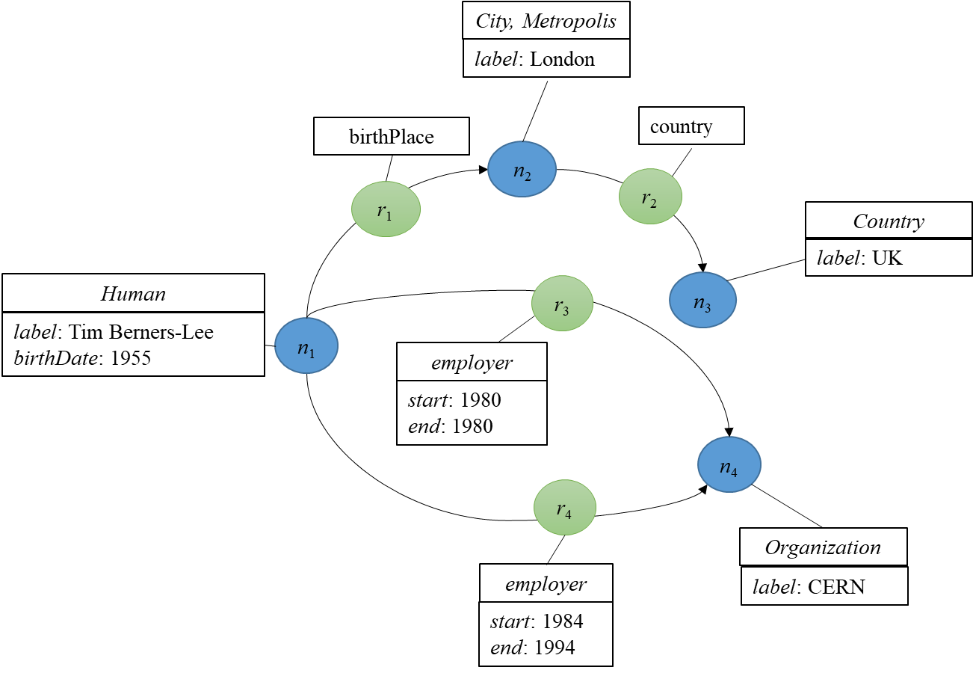
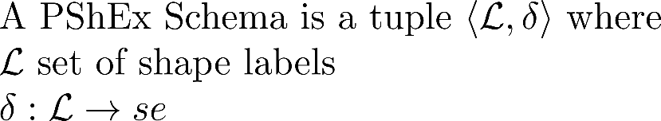
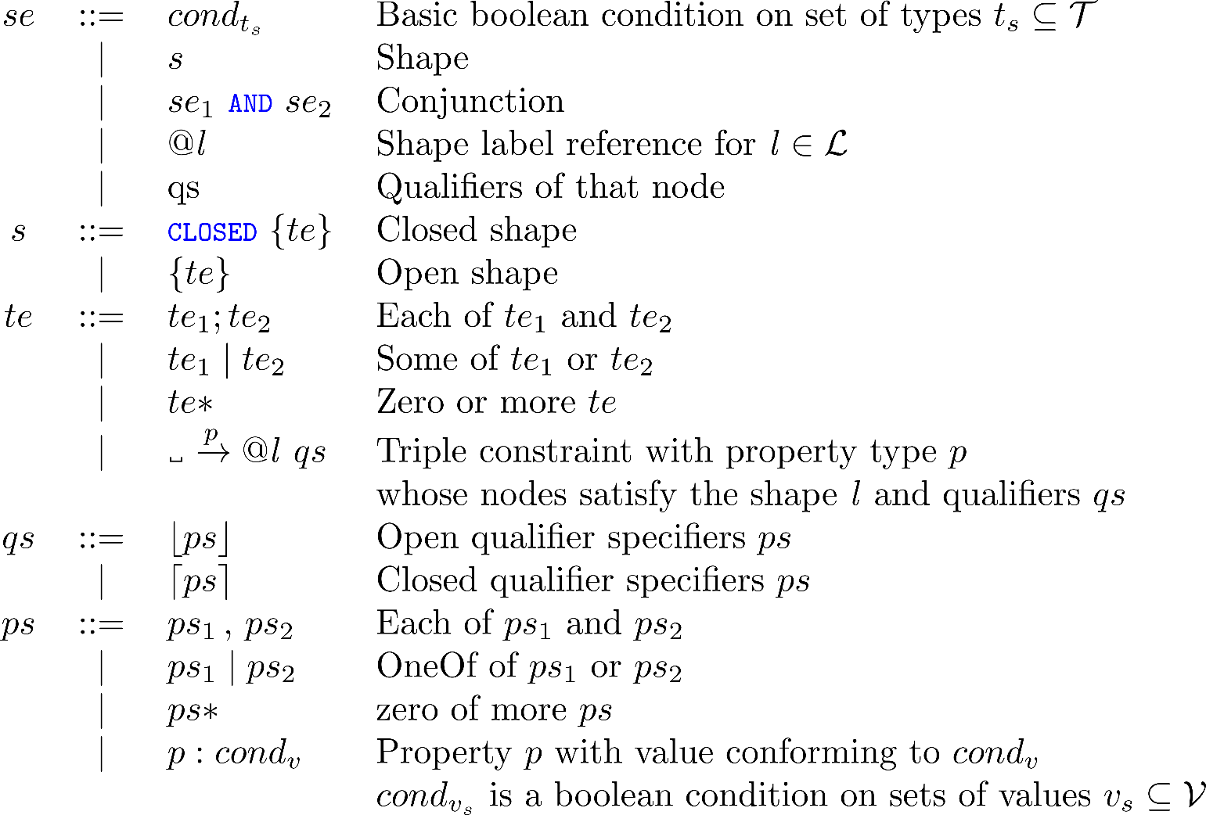
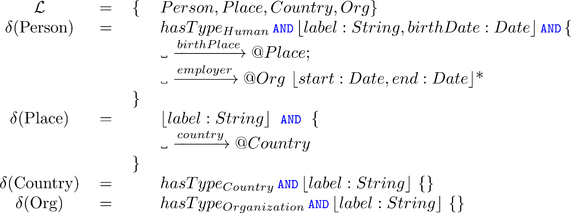
PShEx for property graphs

Slide 15
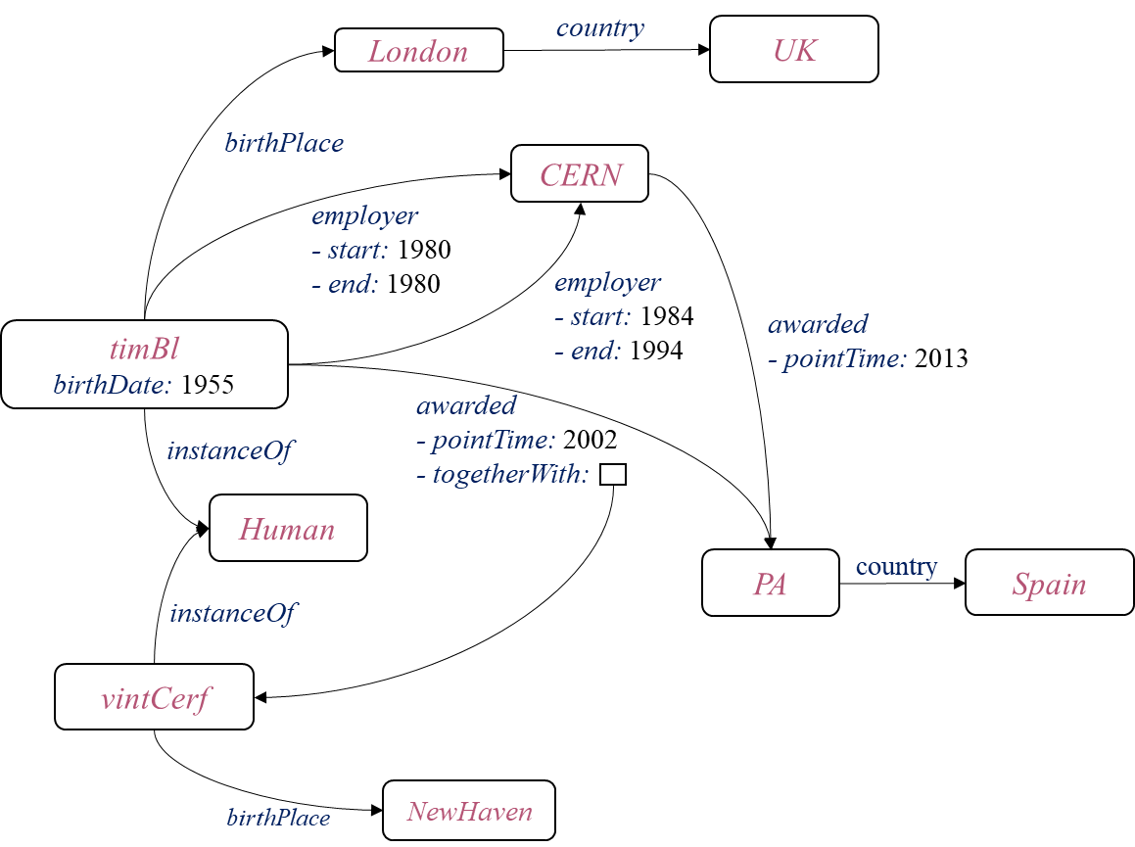
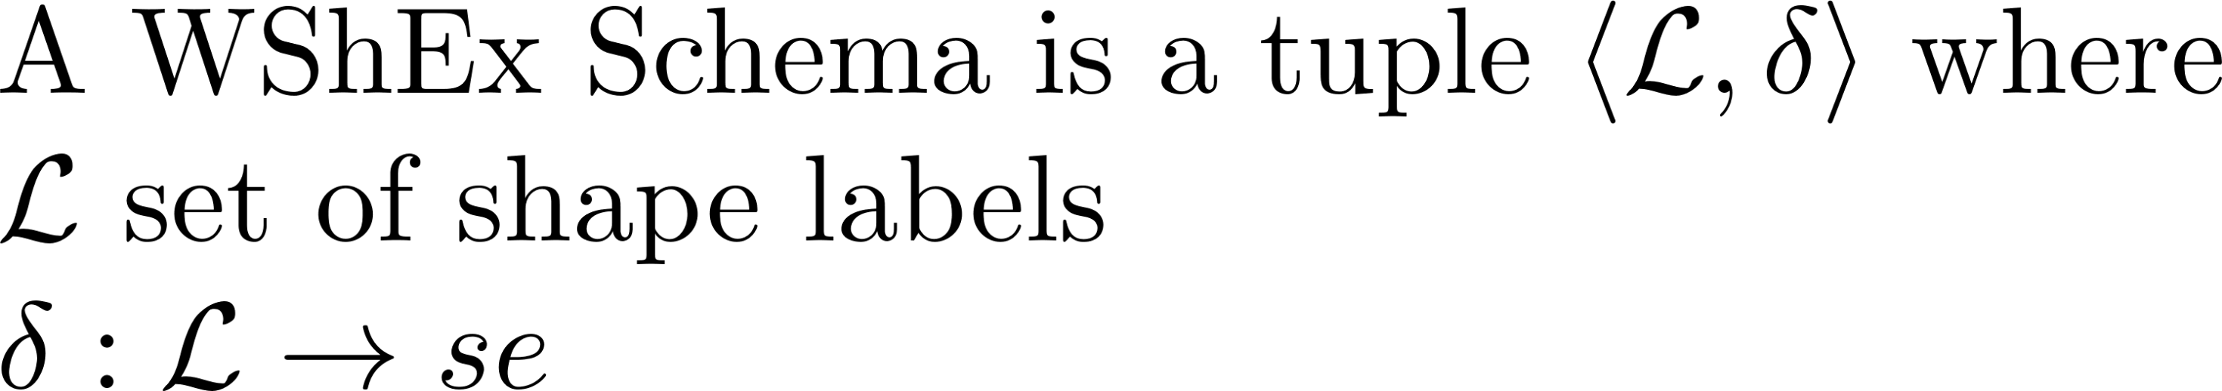
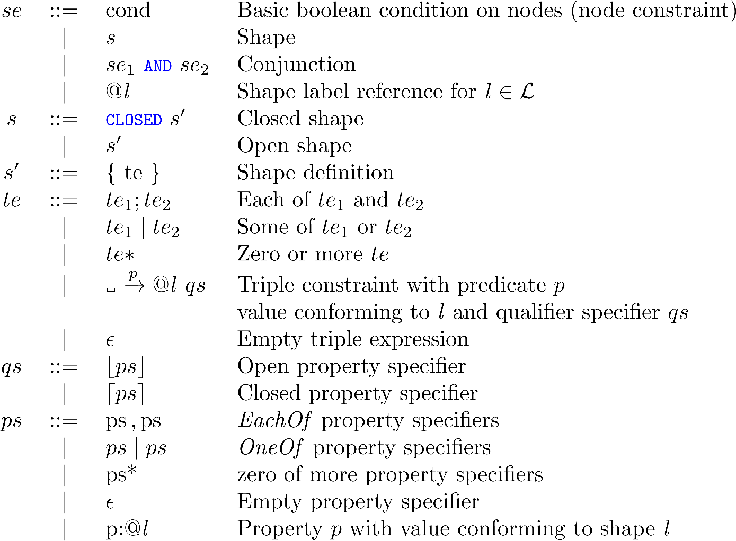
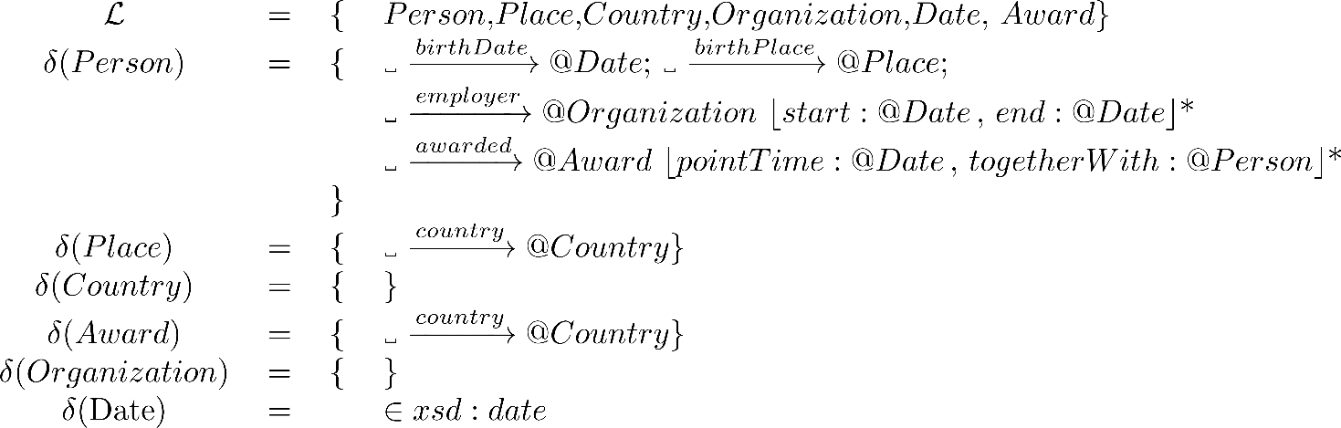
WShEx for Wikibase graphs

Slide 16
What's the role of WShEx
WShEx schemas describe Wikibase data model
Closer to JSON dumps
ShEx (entity schemas) describe RDF serializacion of Wikibase data model
Wikibase
data model
JSON dumps
RDF dumps
serialization
describe
describe
WShEx
ShEx

Slide 17
WShEx ShEx
<Researcher> {
wdt:birthPlace @<Place> ;
p:birthPlace {
ps:birthPlace @<Place>
} ;
wdt:awarded @<Awarded> ;
p:awarded {
ps:awarded @<Awarded> ;
pq:togetherWith @<Researcher> *;
} *
}
<Place> {
wdt:country @<Country> ;
p:country {
ps:country @<Country> }
}
<Country> {}
<Researcher> {
<birthPlace> @<Place> ;
<awarded> @<Award> {{
<togetherWith> @<Researcher> *
}} *
}
<Place> {
<country> @<Country>
}
<Country> {}
Wikibase
data model
JSON dumps
RDF dumps
serialization
describe
describe
WShEx
ShEx

Slide 18
Knowledge graphs subsets
Different approaches
Entity-matching
Simple-matching
ShEx-based matching
ShEx+Slurp
ShEx+Pregel
Knowledge graph
Subset

Slide 19
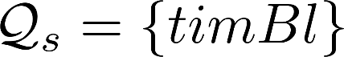
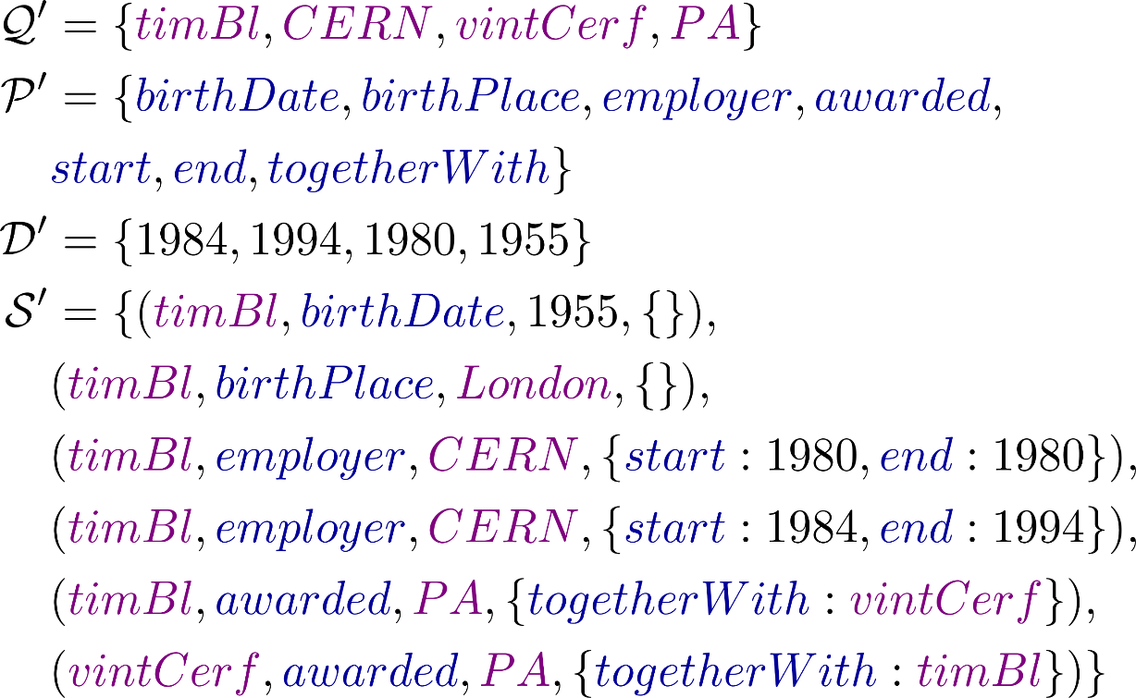
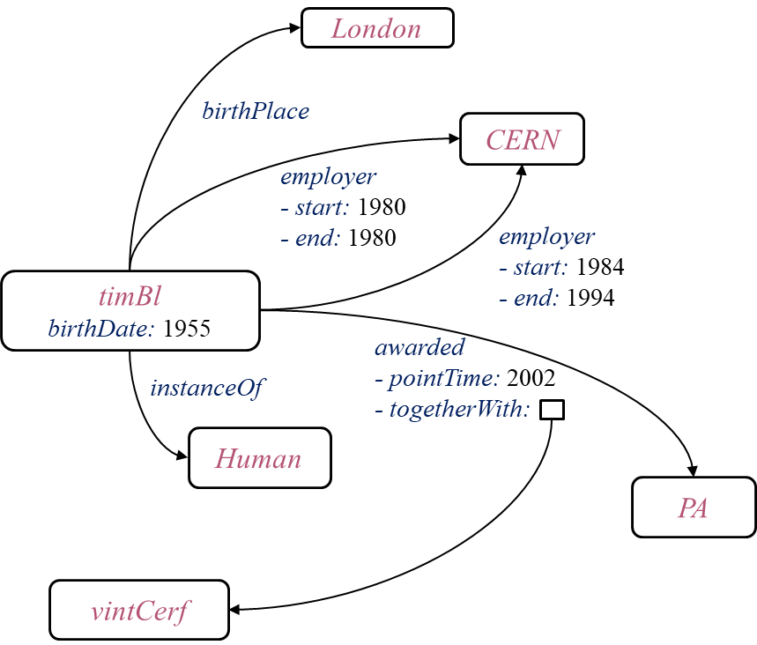
Entity-matching
Directly matches an entity like an ítem, property, etc.
Example:

Slide 20
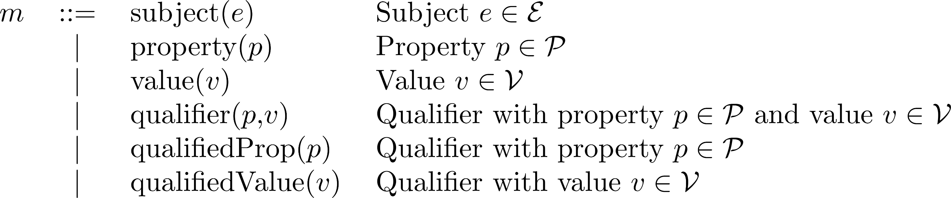
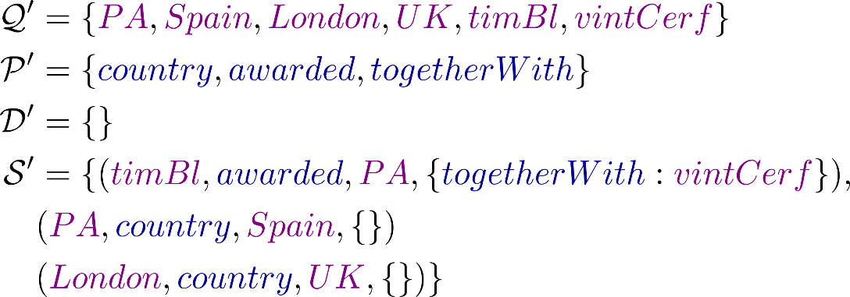
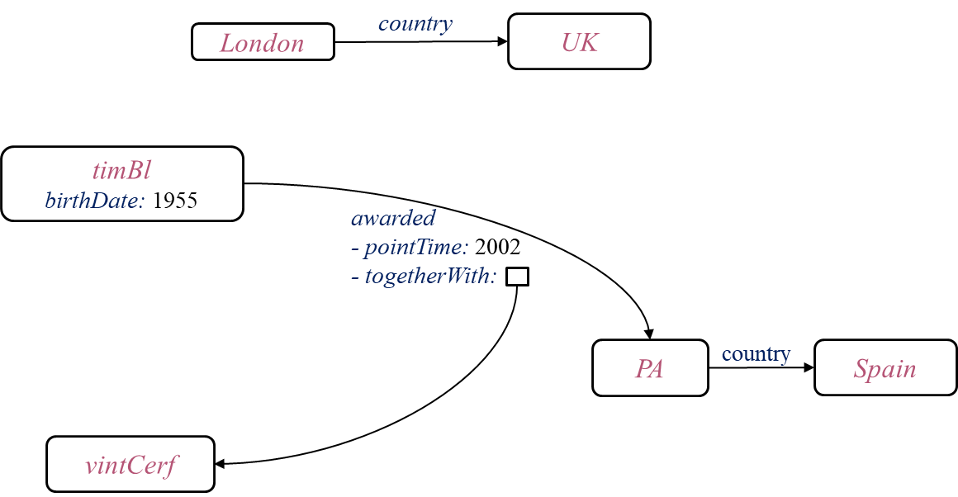
Simple matching
Defines a matching language:
Example:

Slide 21
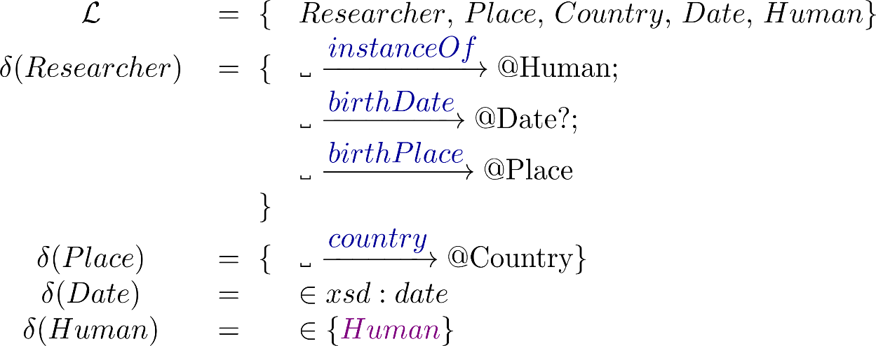
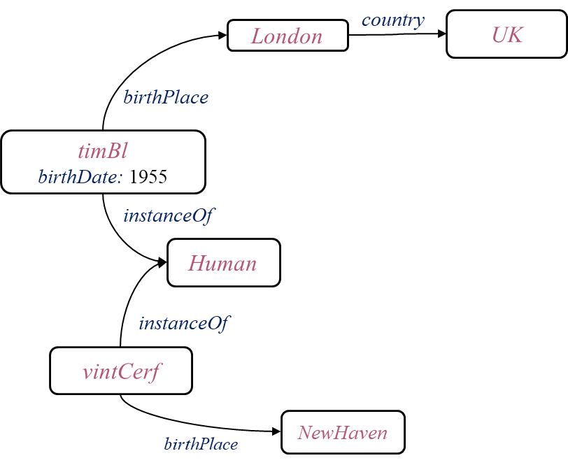
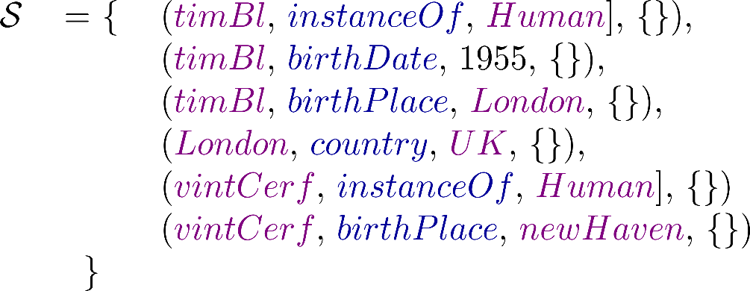
ShEx-based matching
Uses ShEx definitions to match entities
Replaces shape references by true
Doesn't require graph traversal

Slide 22
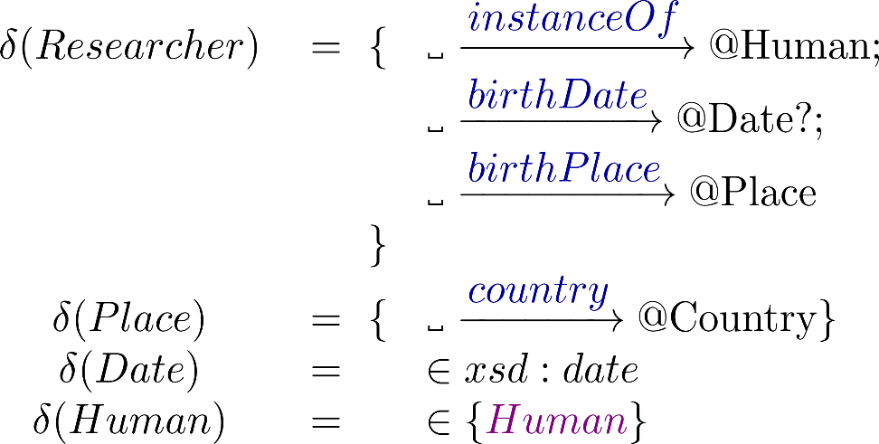
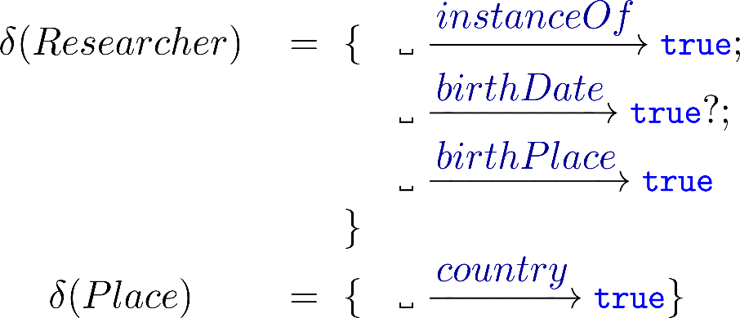
ShEx-based matching
Can be implemented replacing shape references by true
ShEx-based matching has been implemented in WDSub
It allows sequential processing of the dump
It can process the latest Wikidata dump in 5h 15'

Slide 23
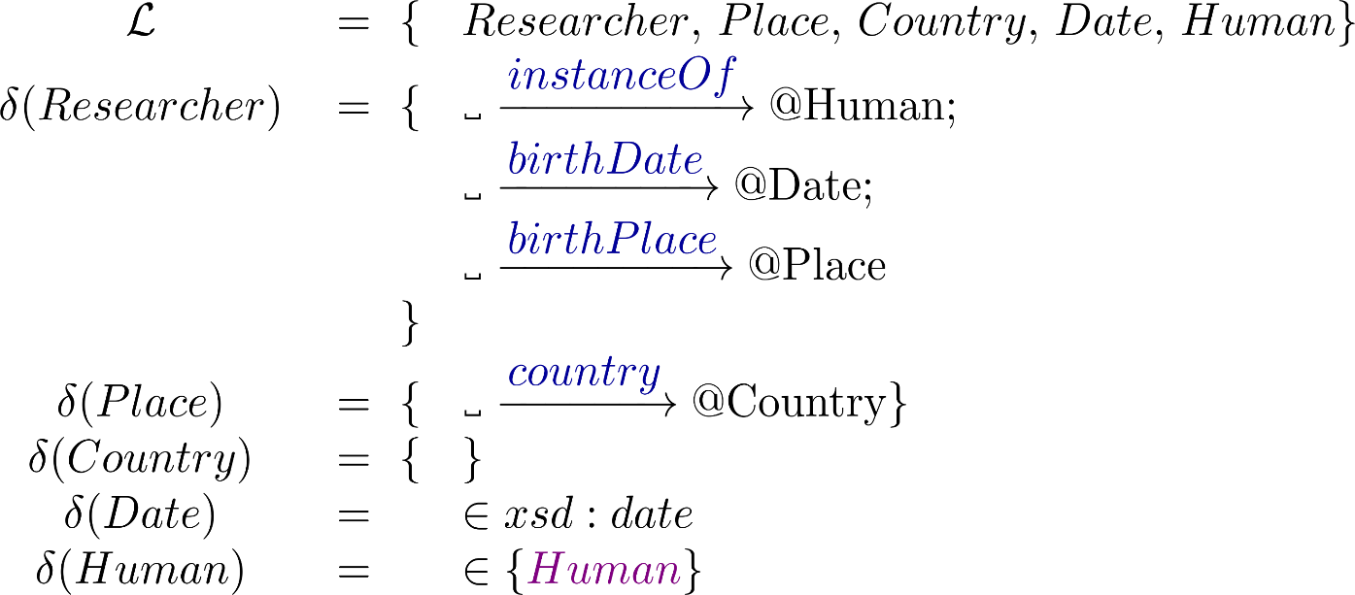
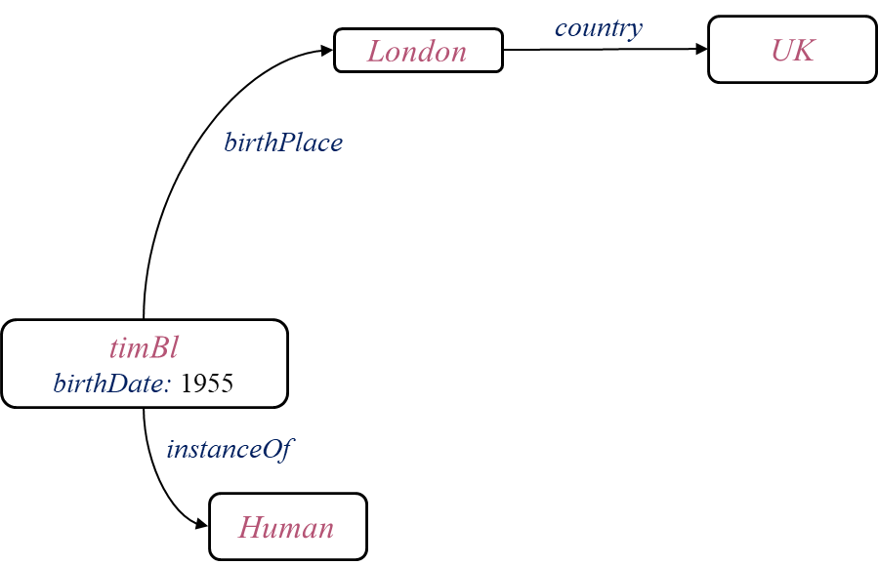
ShEx+slurp
Slurp = Shex option that collects nodes/triples while validating
Example:

Slide 24
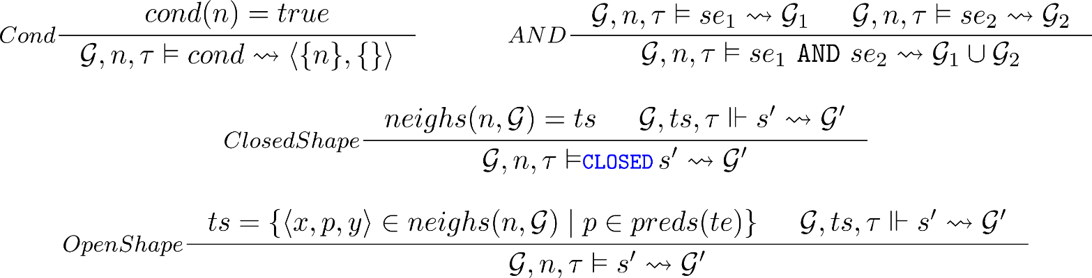
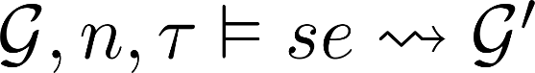
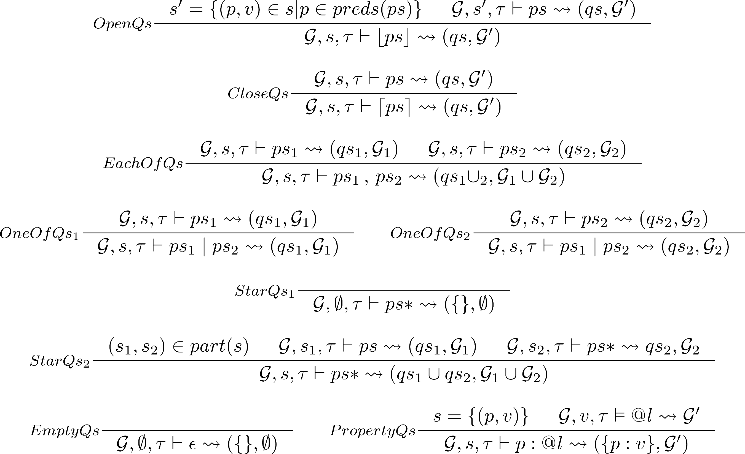
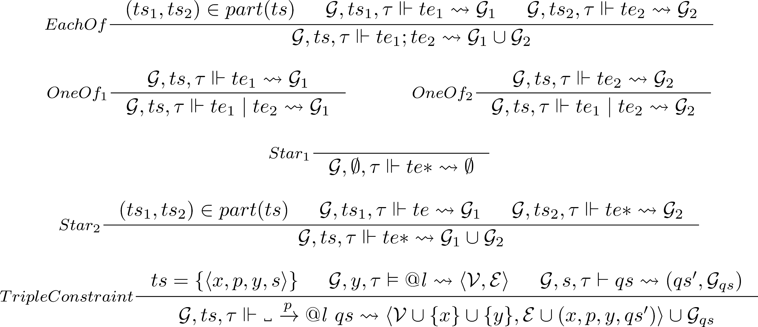
ShEx+Slurp
Formal definition generalizes ShEx semantics
New conformance relation:

Slide 25
ShEx+Slurp
Implemented by shex.js and pyshex
Only for ShEx, not for PShEx or WShEx
It does graph traversal while validating
Difficult to use for processing Wikidata dumps
Subsets include only valid data according to the ShEx
Problems:
Difficult to run behind SPARQL endpoint
Naïve implementation generates too many requests
Optimizations to improve number of SPARQL queries can generate timeouts

Slide 26
ShEx+Pregel
Large scale validation
Based on Pregel algorithm
Developed by Google 2010
Based on Bulk Synchronous Parallel model
Supersteps = units of parallel computation
Communication through messages
Implemented using Apache Spark GraphX library

Slide 27
Think like a vertex
Vertex-centric approach
Each vertice has an id and a state
All vertexes receive an initial message
While messages received do
Run vProg to update vertex state according to messages received
Run sendMsg for each triplet to generate messages
Merge messages by Vertex

Slide 28
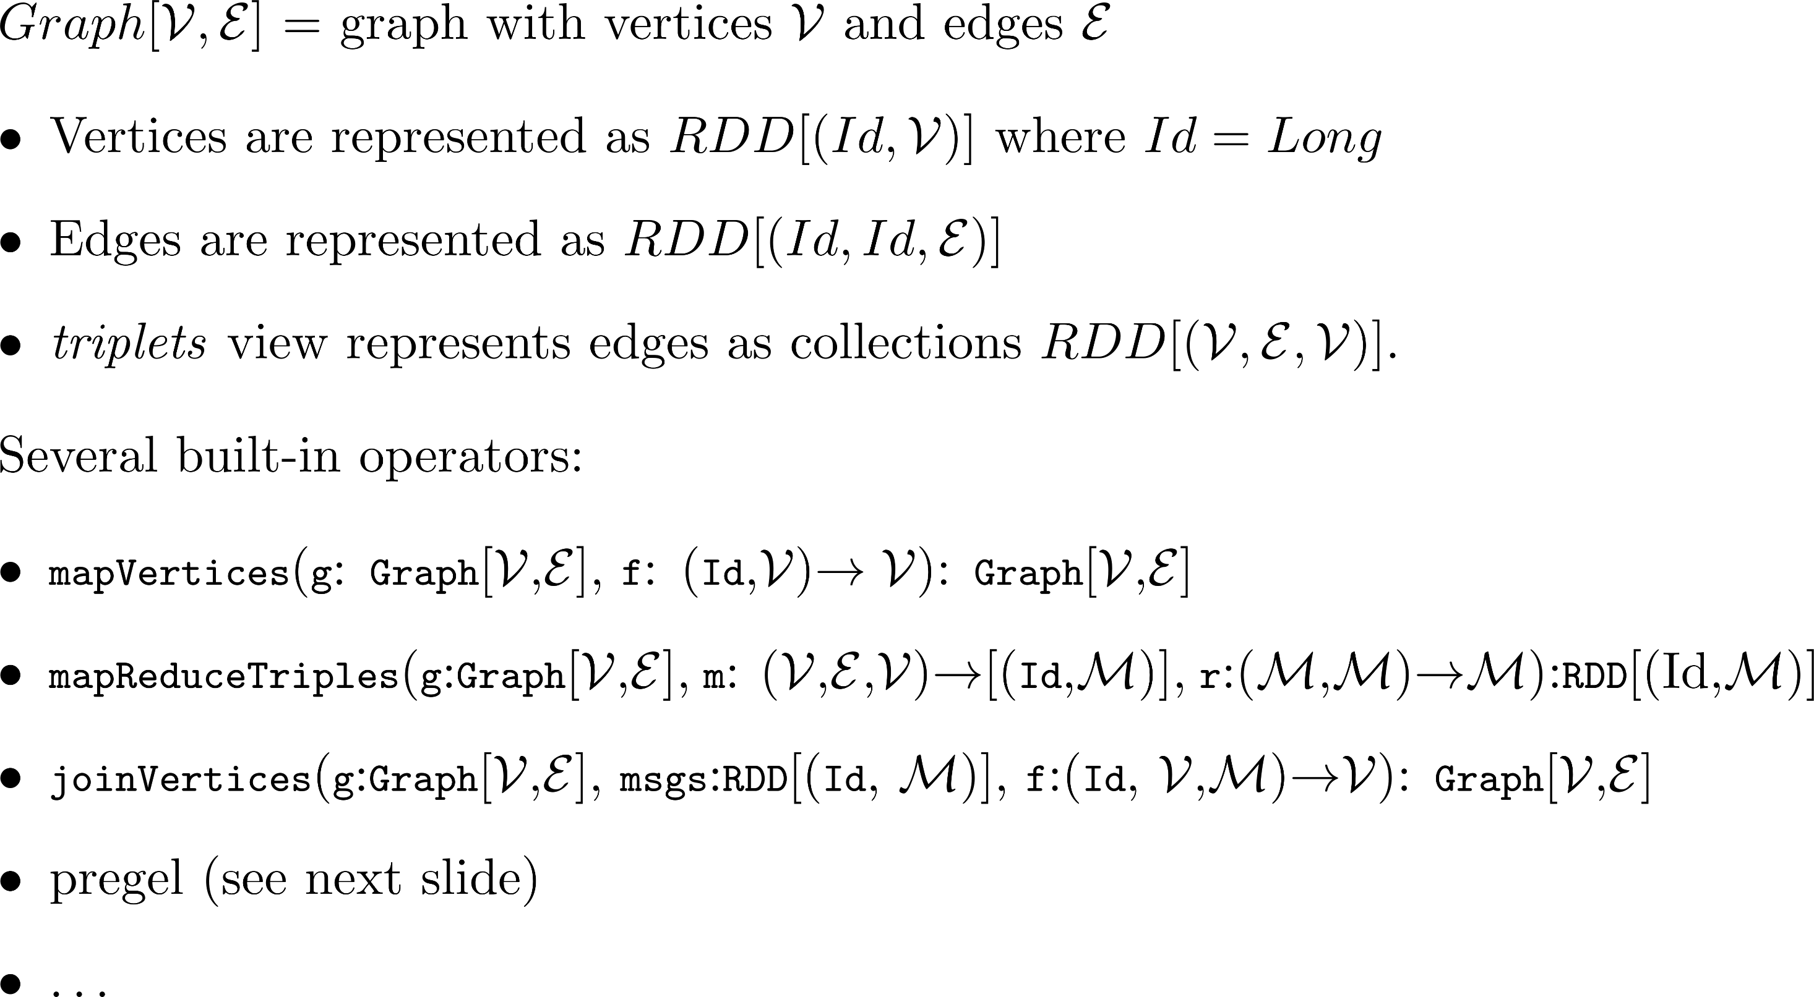
GraphX
Graph API from Apache Spark
RDD (Resilient distributed datasets)
MapReduce in memory

Slide 29
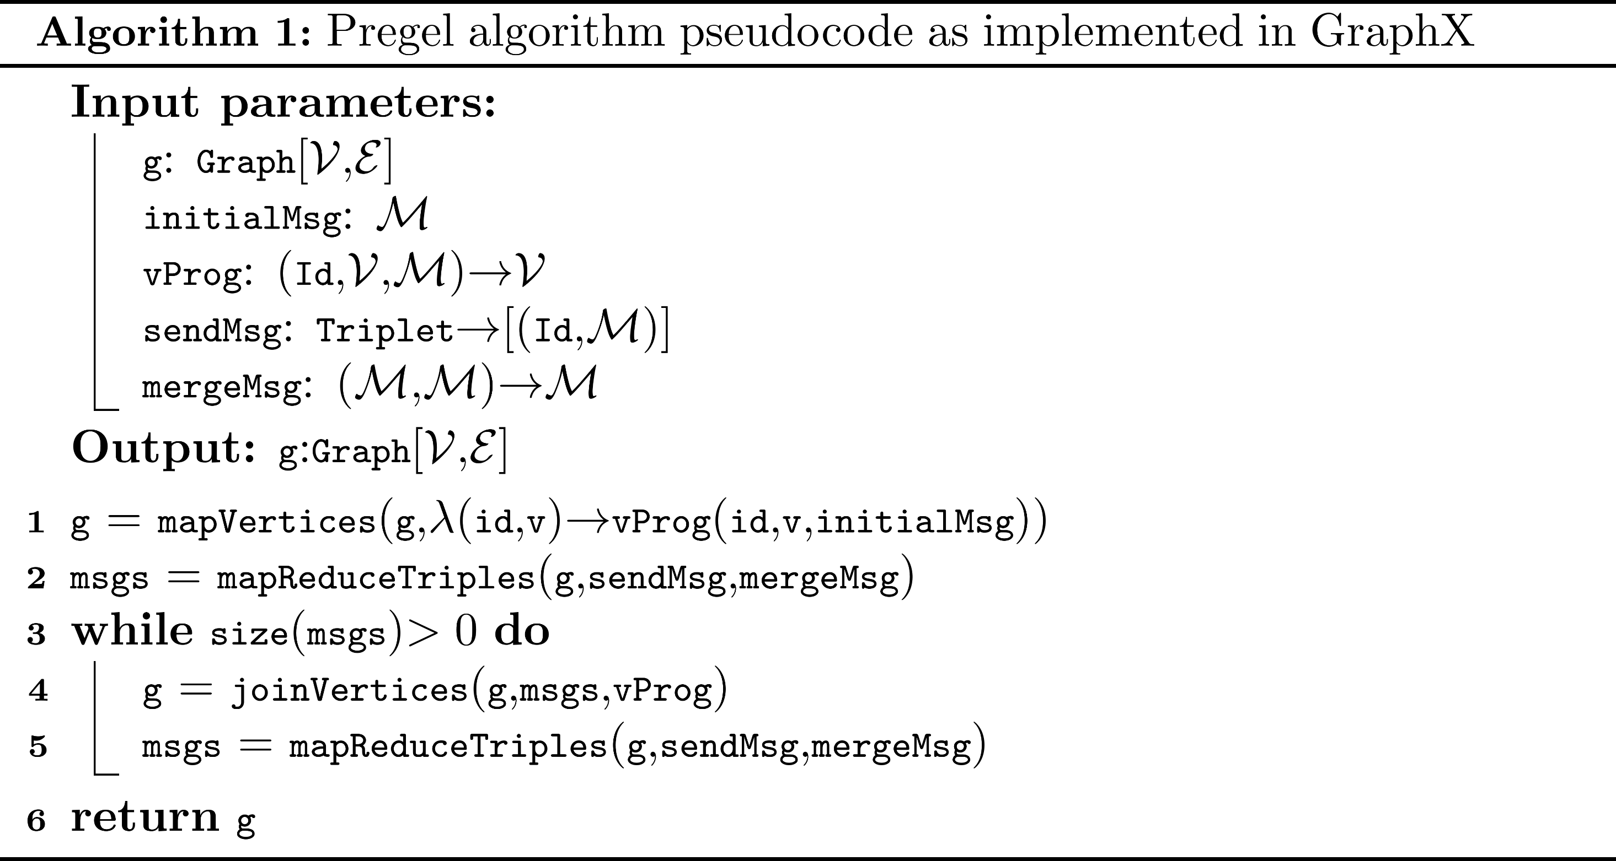
GraphX Pregel pseudo-code

Slide 30
Pregel's vertex state diagram
message received
Inactive
Active
vote to halt

Slide 31
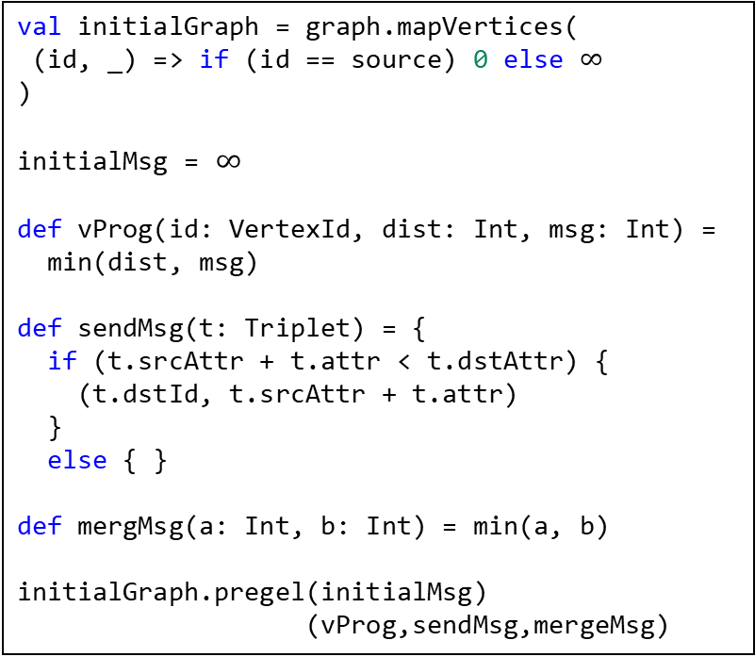
Shortest path to a node
val initialGraph = graph.mapVertices(
(id, _) => if (id == source) 0 else $∞$
)
initialMsg = $∞$
def vProg(id: VertexId, dist: Int, msg: Int) =
min(dist, msg)
def sendMsg(t: Triplet) = {
if (t.srcAttr + t.attr < t.dstAttr) {
(t.dstId, t.srcAttr + t.attr)
}
else { }
def mergMsg(a: Int, b: Int) = min(a, b)
initialGraph.pregel(initialMsg)
(vProg,sendMsg,mergeMsg)
A
5
B
2
D
1
3
C
5

Slide 32
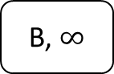
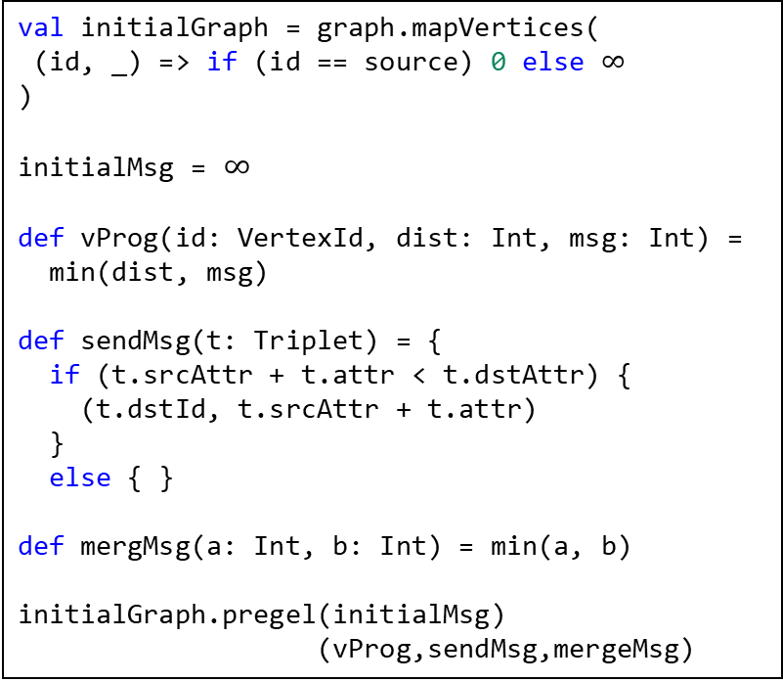
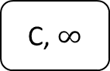
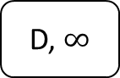
Shortest path to a node
initialGraph
val initialGraph = graph.mapVertices(
(id, _) => if (id == source) 0 else $∞$
)
initialMsg = $∞$
def vProg(id: VertexId, dist: Int, msg: Int) =
min(dist, msg)
def sendMsg(t: Triplet) = {
if (t.srcAttr + t.attr < t.dstAttr) {
(t.dstId, t.srcAttr + t.attr)
}
else { }
def mergMsg(a: Int, b: Int) = min(a, b)
initialGraph.pregel(initialMsg)
(vProg,sendMsg,mergeMsg)
A,0
5
B, $∞$
2
D, $∞$
1
3
C, $∞$
5

Slide 33
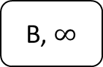
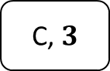
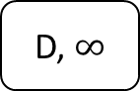
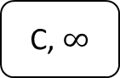

Shortest path to a node
A,0
5
B, $∞$
2
D, $∞$
1
3
C, $∞$
5
val initialGraph = graph.mapVertices(
(id, _) => if (id == source) 0 else $∞$
)
initialMsg = $∞$
def vProg(id: VertexId, dist: Int, msg: Int) =
min(dist, msg)
def sendMsg(t: Triplet) = {
if (t.srcAttr + t.attr < t.dstAttr) {
(t.dstId, t.srcAttr + t.attr)
}
else { }
def mergMsg(a: Int, b: Int) = min(a, b)
initialGraph.pregel(initialMsg)
(vProg,sendMsg,mergeMsg)
Messages
(B, 5)
(C, 3)
A,0
5
B, 5
2
D, $∞$
1
3
C, $3$
5

Slide 34

Shortest path to a node
A,0
5
B, 5
2
D, $∞$
1
3
C, 3
5
val initialGraph = graph.mapVertices(
(id, _) => if (id == source) 0 else $∞$
)
initialMsg = $∞$
def vProg(id: VertexId, dist: Int, msg: Int) =
min(dist, msg)
def sendMsg(t: Triplet) = {
if (t.srcAttr + t.attr < t.dstAttr) {
(t.dstId, t.srcAttr + t.attr)
}
else { }
def mergMsg(a: Int, b: Int) = min(a, b)
initialGraph.pregel(initialMsg)
(vProg,sendMsg,mergeMsg)
Messages
(B, 4)
(D, 7)
(D, 8)
A,0
5
B, 4
2
D, 7
1
3
C, $3$
5

Slide 35

Shortest path to a node
A,0
5
B, 4
2
D, 7
1
3
C, 3
5
val initialGraph = graph.mapVertices(
(id, _) => if (id == source) 0 else $∞$
)
initialMsg = $∞$
def vProg(id: VertexId, dist: Int, msg: Int) =
min(dist, msg)
def sendMsg(t: Triplet) = {
if (t.srcAttr + t.attr < t.dstAttr) {
(t.dstId, t.srcAttr + t.attr)
}
else { }
def mergMsg(a: Int, b: Int) = min(a, b)
initialGraph.pregel(initialMsg)
(vProg,sendMsg,mergeMsg)
Messages (D, 6)
A,0
5
B, 4
2
D, 6
1
3
C, $3$
5

Slide 36
Idea: Validate graphs using Pregel?
Associate each node with a status map
Status map contains information about node conformance to shapes
Messages =
Requests to validate
Request to wait for neighbours
Information about validated/failed neighbours
Initial message = request to validate start shape
In each iteration we collect information from neighbours conformance
We provide 3 parameters
checkLocal: tries to check conformance of a node locally or return pending neighbours
checkNeighs: checks neighbours with regular expression defined by a shape
tripleConstraints: return the triple constraints associated with a shape label

Slide 37
State diagram
Inactive
Active
Undefined
validate
Pending
validate
validate
waitFor(ds')
OK/Failed
WaitingFor(ds,oks,fs)
checked(oks',fs')
validate
checked(oks', fs')
waitFor(ds')

Slide 38
WShEx
Schema
start = <Researcher> {
instanceOf @<Human> ;
birthDate Date? ;
birthPlace @<Place> ;
}
<Human> [ Human ]
<Place> {
country @<Country>
}
<Country> { }
Trace of PSchema
London
country
UK
birthPlace
CERN
employer
- start: 1980
- end: 1980
employer
- start: 1984
- end: 1994
timBl
birthDate: 1955
awarded
- pointTime: 2013
awarded
- pointTime: 2002
- togetherWith:
instanceOf
Human
country
PA
Spain
instanceOf
vintCerf
NewHaven
birthPlace

Slide 39
WShEx
Schema
start = <R> {
instanceOf @<H> ;
birthDate Date? ;
birthPlace @<P> ;
}
<H> [ Human ]
<P> {
country @<C>
}
<C> { }
Trace of PSchema
London
country
UK
birthPlace
CERN
employer
- start: 1980
- end: 1980
employer
- start: 1984
- end: 1994
timBl
birthDate: 1955
awarded
- pointTime: 2013
awarded
- pointTime: 2002
- togetherWith:
instanceOf
Human
country
PA
Spain
instanceOf
vintCerf
New Haven
birthPlace

Slide 40
Schema
start = <R> {
instanceOf @<H> ;
birthDate Date? ;
birthPlace @<P> ;
}
<H> [ Human ]
<P> {
country @<C>
}
<C> { }
Superstep 0. All nodes asked to validate start = <R>
validate: {<R>}
validate: {<R>}
London
country
UK
birthPlace
validate: {<R>}
CERN
employer
- start: 1980
- end: 1980
Messages at superstep 0
validate: {<R>}
employer
- start: 1984
- end: 1994
(timBl, validate: <R>),
(London, validate: <R>),
(UK, validate: <R>),
(CERN, validate: <R>),
(PA, validate: <R>),
(Spain, validate: <R>),
(Human, validate: <R>),
(vintCerf, validate: <R>)
(newHaven, validate: <R>)
timBl
birthDate: 1955
awarded
- pointTime: 2013
awarded
- pointTime: 2002
- togetherWith:
instanceOf
validate: {<R>}
Human
validate: {<R>}
validate: {<R>}
country
Spain
PA
validate: {<R>}
vintCerf
instanceOf
validate: {<R>}
New Haven
birthPlace

Slide 41
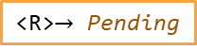

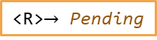

Schema
start = <R> {
instanceOf @<H> ;
birthDate Date? ;
birthPlace @<P> ;
}
<H> [ Human ]
<P> {
country @<C>
}
<C> { }
Superstep 0. After vprog
London
country
UK
<R>$→$ Pending
<R>$→$ Pending
birthPlace
<R>$→$ Pending
CERN
employer
- start: 1980
- end: 1980
employer
- start: 1984
- end: 1994
timBl
birthDate: 1955
awarded
- pointTime: 2013
<R>$→$ Pending
awarded
- pointTime: 2002
- togetherWith:
instanceOf
Human
country
<R>$→$ Pending
PA
Spain
<R>$→$ Pending
<R>$→$ Pending
instanceOf
vintCerf
<R>$→$ Pending
New Haven
birthPlace
<R>$→$ Pending

Slide 42


Schema
start = <R> {
instanceOf @<H> ;
birthDate Date? ;
birthPlace @<P> ;
}
<H> [ Human ]
<P> {
country @<C>
}
<C> { }
Superstep 1. Collecting messages
London
country
UK
<R>$→$ Pending
<R>$→$ Pending
birthPlace
<R>$→$ Pending
CERN
Msgs
employer
- start: 1980
- end: 1980
timBl $⟼$ waitFor({<R>,(London,birthPlace,<P>)})
London $⟼$ validate({<P>})
timBl $⟼$ waitFor({<R>,(Human,instanceOf,<H>)})
Human $⟼$ validate({<H>})
vintCerf$⟼$ waitFor({<R>,(Human,instanceOf,<H>)})
Human $⟼$ validate({<H>})
vintCerf$⟼$ waitFor({<R>,(NewHaven,instanceOf,<H>)})
NewHaven$⟼$ validate({<P>})
employer
- start: 1984
- end: 1994
timBl
birthDate: 1955
awarded
- pointTime: 2013
<R>$→$ Pending
awarded
- pointTime: 2002
- togetherWith:
instanceOf
Human
country
<R>$→$ Pending
PA
Spain
instanceOf
<R>$→$ Pending
<R>$→$ Pending
vintCerf
<R>$→$ Pending
New Haven
birthPlace
<R>$→$ Pending

Slide 43
Schema
start = <R> {
instanceOf @<H> ;
birthDate Date? ;
birthPlace @<P> ;
}
<H> [ Human ]
<P> {
country @<C>
}
<C> { }
Superstep 1. Collecting messages
validate({<P>})
country
London
UK
<R>$→$ Pending
<R>$→$ Pending
birthPlace
<R>$→$ Pending
CERN
Msgs
employer
- start: 1980
- end: 1980
waitFor({<R>, (birthPlace, <P>)}
waitFor({<R>, (instanceOf, <H>)}
(timBl, waitFor({<R>, (London,birthPlace,<P>)})
(London, validate({<P>})
(timBl, waitFor({<R>, (Human,instanceOf,<H>)})
(Human, validate({<H>})
(vintCerf, waitFor({<R>, (Human,instanceOf,<H>)})
(Human, validate({<H>})
employer
- start: 1984
- end: 1994
timBl
birthDate: 1955
awarded
- pointTime: 2013
<R>$→$ Pending
awarded
- pointTime: 2002
- togetherWith:
instanceOf
validate({<H>})
Human
country
<R>$→$ Pending
PA
Spain
instanceOf
waitFor(<R>, (instanceOf, <H>)
<R>$→$ Pending
<R>$→$ Pending
vintCerf
<R>$→$ Pending
validate({<P>})
New Haven
birthPlace
<R>$→$ Pending

Slide 44







Schema
start = <R> {
instanceOf @<H> ;
birthDate Date? ;
birthPlace @<P> ;
}
<H> [ Human ]
<P> {
country @<C>
}
<C> { }
Superstep 1. After vprog.
London
country
UK
<R>$→$ Failed
<P>$→$ Pending
<R>$→$ Failed
birthPlace
CERN
<R>$→$ Failed
employer
- start: 1980
- end: 1980
employer
- start: 1984
- end: 1994
timBl
birthDate: 1955
awarded
- pointTime: 2013
<R>$→$ WaitingFor({(London, birthPlace,<P>),
(Human, instanceOf,<H>)},
oks: {}, failed: {})
awarded
- pointTime: 2002
- togetherWith:
instanceOf
Human
country
<R>$→$ Failed
<H>$→$ OK
PA
Spain
instanceOf
<R>$→$ Failed
<R>$→$ Failed
vintCerf
<R>$→$ WaitingFor({(instanceOf,<H>)}
oks: {}, failed: {}
)
New Haven
birthPlace
<R>$→$ Failed

Slide 45




Schema
start = <R> {
instanceOf @<H> ;
birthDate Date? ;
birthPlace @<P> ;
}
<H> [ Human ]
<P> {
country @<C>
}
<C> { }
Superstep 2. Collecting new messages.
London
country
UK
<R>$→$ Failed
<P>$→$ Pending
<R>$→$ Failed
birthPlace
CERN
<R>$→$ Failed
Msgs
employer
- start: 1980
- end: 1980
awarded
- pointTime: 2013
London $⟼$ waitFor({<P>,(London,country,<C>)})
UK $⟼$ validate({<C>})
timBl$⟼$Checked({<R>,(Human,instanceOf,<H>)},{})
vintCerf$⟼$Checked({<R>,(Human,instanceOf,<H>)},{})
vintCerf$⟼$Checked({<R>,{},{(NewHaven,birthPlace,<P>)})
employer
- start: 1984
- end: 1994
timBl
birthDate: 1955
<R>$→$ WaitingFor({(London, birthPlace,<P>),
(Human, instanceOf,<H>)},
oks: {}, failed: {})
awarded
- pointTime: 2002
- togetherWith:
instanceOf
Human
country
<R>$→$ Failed
<H>$→$ OK
PA
Spain
instanceOf
<R>$→$ Failed
<R>$→$ Failed
vintCerf
<R>$→$ WaitingFor({(instanceOf,<H>)}
oks: {}, failed: {}
)
New Haven
birthPlace
<R>$→$ Failed
<P>$→$ Failed

Slide 46



Schema
start = <R> {
instanceOf @<H> ;
birthDate Date? ;
birthPlace @<P> ;
}
<H> [ Human ]
<P> {
country @<C>
}
<C> { }
Superstep 2. After vprog
waitFor({<P>, (country, <C>)}
validate(<C>})
London
country
UK
<R>$→$ Failed
<P>$→$ Pending
<R>$→$ Failed
birthPlace
CERN
<R>$→$ Failed
Msgs
employer
- start: 1980
- end: 1980
London $⟼$ waitFor({<P>, (UK, country, <C>)})
UK $⟼$ validate({<C>})
timBl $⟼$ ok({<R>, (Human, instanceOf, <H>)})
vintCerf $⟼$ ok({<R>, (Human, instanceOf, <H>)})
ok({<R>, (instanceOf, <H>)}
employer
- start: 1984
- end: 1994
timBl
birthDate: 1955
awarded
- pointTime: 2013
<R>$→$ WaitingFor({(London,birthPlace,<P>),
(Human,instanceOf,<H>)},
oks: {}, failed: {})
awarded
- pointTime: 2002
- togetherWith:
instanceOf
Human
country
<R>$→$ Failed
<H>$→$ OK
PA
Spain
instanceOf
ok({<R>, (instanceOf, <H>)}
<R>$→$ Failed
<R>$→$ Failed
vintCerf
<R>$→$ WaitingFor({(Human,instanceOf,<H>)}
oks: {}, failed: {}
)
New Haven
birthPlace
<R>$→$ Failed

Slide 47








Schema
start = <R> {
instanceOf @<H> ;
birthDate Date? ;
birthPlace @<P> ;
}
<H> [ Human ]
<P> {
country @<C>
}
<C> { }
Superstep 2. After vprog
London
country
UK
<R>$→$ Failed
<P>$→$ WaitingFor({(UK,country,<C>)})
<R>$→$ Failed
<C>$→$ OK
birthPlace
CERN
<R>$→$ Failed
employer
- start: 1980
- end: 1980
employer
- start: 1984
- end: 1994
timBl
birthDate: 1955
awarded
- pointTime: 2013
<R>$→$ WaitingFor({(birthPlace,<P>)},
oks: {(instanceOf,<H>)},
failed: {})
awarded
- pointTime: 2002
- togetherWith:
instanceOf
Human
country
<R>$→$ Failed
<H>$→$ OK
PA
Spain
instanceOf
<R>$→$ Failed
<R>$→$ Failed
vintCerf
<R>$→$Failed
New Haven
<R>$→$ WaitingFor({}
oks: {(Human, instanceOf,<H>)},
failed: {})
birthPlace
$$⇒$$
<R>$→$Failed
<R>$→$ Failed
<P>$→$ Failed

Slide 48



Schema
start = <R> {
instanceOf @<H> ;
birthDate Date? ;
birthPlace @<P> ;
}
<H> [ Human ]
<P> {
country @<C>
}
<C> { }
Superstep 3. Collecting messages
ok({<P>, (country, <C>)}
London
country
UK
<R>$→$ Failed
<P>$→$ WaitingFor({(country,<C>)})
<R>$→$ Failed
<C>$→$ OK
birthPlace
CERN
<R>$→$ Failed
Msgs
employer
- start: 1980
- end: 1980
London $⟼$ ok(<P>, (UK, country, <C>))
employer
- start: 1984
- end: 1994
timBl
birthDate: 1955
awarded
- pointTime: 2013
<R>$→$ WaitingFor({(birthPlace,<P>)},
oks: {(instanceOf,<H>)},
failed: {})
awarded
- pointTime: 2002
- togetherWith:
instanceOf
Human
country
<R>$→$ Failed
<H>$→$ OK
PA
Spain
instanceOf
<R>$→$ Failed
<R>$→$ Failed
vintCerf
<R>$→$Failed
New Haven
birthPlace
<R>$→$ Failed
<P>$→$ Failed

Slide 49






Schema
start = <R> {
instanceOf @<H> ;
birthDate Date? ;
birthPlace @<P> ;
}
<H> [ Human ]
<P> {
country @<C>
}
<C> { }
Superstep 3. After vprog
London
country
UK
<R>$→$ Failed
<P>$→$OK
<R>$→$ Failed
<C>$→$ OK
birthPlace
CERN
<R>$→$ Failed
employer
- start: 1980
- end: 1980
employer
- start: 1984
- end: 1994
timBl
birthDate: 1955
awarded
- pointTime: 2013
<R>$→$ WaitingFor({(London,birthPlace,<P>)},
oks: {(Human,instanceOf,<H>)},
failed: {})
awarded
- pointTime: 2002
- togetherWith:
instanceOf
Human
country
<R>$→$ Failed
<H>$→$ OK
PA
Spain
instanceOf
<R>$→$ Failed
<R>$→$ Failed
vintCerf
<R>$→$Failed
New Haven
<R>$→$ Failed
<P>$→$ WaitingFor({},
oks:{(country, <C>)}, failed: {})
$$⇒$$
<R>$→$ Failed
<P>$→$OK
birthPlace
<R>$→$ Failed
<P>$→$ Failed

Slide 50
Schema
start = <R> {
instanceOf @<H> ;
birthDate Date? ;
birthPlace @<P> ;
}
<H> [ Human ]
<P> {
country @<C>
}
<C> { }
Superstep 4. Collecting messages
London
country
UK
<R>$→$ Failed
<P>$→$OK
<R>$→$ Failed
<C>$→$ OK
birthPlace
CERN
<R>$→$ Failed
Msgs
employer
- start: 1980
- end: 1980
timBl $⟼$ ok(<R>, (London, birthPlace, <P>))
ok({<R>, (birthPlace, <P>)}
employer
- start: 1984
- end: 1994
timBl
birthDate: 1955
awarded
- pointTime: 2013
<R>$→$ WaitingFor({(birthPlace,<P>)},
oks: {(instanceOf,<H>)},
failed: {})
awarded
- pointTime: 2002
- togetherWith:
instanceOf
Human
country
<R>$→$ Failed
<H>$→$ OK
PA
Spain
instanceOf
<R>$→$ Failed
<R>$→$ Failed
vintCerf
<R>$→$Failed
New Haven
birthPlace
<R>$→$ Failed
<P>$→$ Failed

Slide 51



Schema
start = <R> {
instanceOf @<H> ;
birthDate Date? ;
birthPlace @<P> ;
}
<H> [ Human ]
<P> {
country @<C>
}
<C> { }
Superstep 4. After vprog
London
country
UK
<R>$→$ Failed
<P>$→$OK
<R>$→$ Failed
<C>$→$ OK
birthPlace
CERN
<R>$→$ Failed
employer
- start: 1980
- end: 1980
employer
- start: 1984
- end: 1994
timBl
birthDate: 1955
awarded
- pointTime: 2013
<R>$→$ Ok
awarded
- pointTime: 2002
- togetherWith:
instanceOf
Human
country
<R>$→$ Failed
<H>$→$ OK
PA
Spain
instanceOf
<R>$→$ Failed
<R>$→$ Failed
vintCerf
<R>$→$Failed
New Haven
<R>$→$ WaitingFor({},
oks:{(instanceOf, <H>),
(birthPlace, <P>)},
failed: {})
$$⇒$$
<R>$→$ Ok
birthPlace
<R>$→$ Failed
<P>$→$ Failed

Slide 52
Schema
start = <R> {
instanceOf @<H> ;
birthDate Date? ;
birthPlace @<P> ;
}
<H> [ Human ]
<P> {
country @<C>
}
<C> { }
End state: All nodes inactive, no more messages
London
country
UK
<R>$→$ Failed
<P>$→$OK
<R>$→$ Failed
<C>$→$ OK
birthPlace
CERN
<R>$→$ Failed
employer
- start: 1980
- end: 1980
employer
- start: 1984
- end: 1994
timBl
birthDate: 1955
awarded
- pointTime: 2013
<R>$→$ Ok
awarded
- pointTime: 2002
- togetherWith:
instanceOf
Human
country
<R>$→$ Failed
<H>$→$ OK
PA
Spain
instanceOf
<R>$→$ Failed
<R>$→$ Failed
vintCerf
<R>$→$Failed
New Haven
birthPlace
<R>$→$ Failed
<P>$→$ Failed

Slide 53
Schema
start = <R> {
instanceOf @<H> ;
birthDate Date? ;
birthPlace @<P> ;
}
<H> [ Human ]
<P> {
country @<C>
}
<C> { }
Wikibase Subgraph: entities with some OK shape
London
country
UK
<R>$→$ Failed
<P>$→$OK
<R>$→$ Failed
<C>$→$ OK
birthPlace
timBl
birthDate: 1955
<R>$→$ Ok
instanceOf
Human
<R>$→$ Failed
<H>$→$ OK

Slide 54


Status and Messages

Slide 55

Adapting Pregel to validate graphs using ShEx
Parameters
InitialLabel, start label
checkLocal, attempts to check if a node conforms locally. Possible results:
Ok
Failed
Pending(ls)
checkNeighs, attempts to check the neighbourhood of a node. Result:
Ok
Failed
tripleConstraints: set of constraints associated with a label

Slide 56



vProg definition

Slide 57


sendMsg

Slide 58

mergeMsg

Slide 59

checkLocal
Checks if it is possible to validate a node locally
Returns
Ok: Node conforms
Failed: Node doesn't conform
Pending(ls) conformance depends on neighbours
checkLocal(<Human>, Human) = Ok
checkLocal(<Researcher>, Human) = Failed
checkLocal(<Researcher>, timBl) = Pending { <Human>, <Place> }
start = <Researcher>
<Researcher> {
instanceOf @<Human> ;
birthDate Date? ;
birthPlace @<Place> ;
}
<Human> [ Human ]
<Place> {
country @<Country>
}
<Country> { }

Slide 60
checkNeighs
Checks if the bag of neighbours of a node conform to the regular bag expression defined by a shape
Returns: ok (conforms), failed (doesn't)
checkNeighs(<Researcher>, {(instanceOf, <Human>), (birthPlace, <London>)}, {}) = Ok
checkNeighs(<Researcher>, {(instanceOf, <Human>) }, {}) = Failed
rbe(<Researcher>) = (instanceOf, <Human>);
(birthPlace, <Place>)
start = <Researcher>
<Researcher> {
instanceOf @<Human> ;
birthDate Date? ;
birthPlace @<Place> ;
}
<Human> [ Human ]
<Place> {
country @<Country>
}
<Country> { }

Slide 61
tripleConstraints
Returns the triple constraints of a shape label
tripleConstraints(<Researcher>) = {(instanceOf, <Human>), (birthPlace, <Place>)}
tripleConstraints(<Human>) = {}
tripleConstraints(<Place>) = {(country, <Country>)}
tripleConstraints(<Country>) = {}
start = <Researcher>
<Researcher> {
instanceOf @<Human> ;
birthDate Date? ;
birthPlace @<Place> ;
}
<Human> [ Human ]
<Place> {
country @<Country>
}
<Country> { }

Slide 62
Preliminary results
Implemented in SparkWDSub using Apache Spark GraphX
No optimizations applied
Latest Wikidata dumps on AWS can be processed on AWS
512 cores, 3.904 Gb RAM, 121.600 Gb disk
For 2014 Wikidata dump (31.3 GB uncompressed) in 3 minutes
For 2021 Wikidata dump (1.256,55 Gb uncompressed) it took 36 minutes
Only for simple schemas yet

Slide 63
Conclusions
Formal definition of Knowledge graphs
RDF graphs, property graphs, wikibase graphs
ShEx extension for property graphs/wikibase graphs
Formal definition of wikibase graphs subsets
Scalable approach to validate big knowledge graphs
Inspired by Pregel algorithm (Spark GraphX)

Slide 64
Repaso de contribuciones
 | Grafos RDF | Property graphs | Grafos Wikibase
Definición formal | Realizado previamente | Realizado previamente | Presente trabajo
Descripción grafos conocimiento | ShEx Realizado anteriormente | PShEx Presente trabajo | WShEx Presente trabajo
Entity-generated (definición) | - | - | Presente trabajo
Entity-generated (implementación) | - | - | WDumper
Simple matching (definición) | - | - | Presente trabajo
Simple matching (implementación) | - | - | Wdumper
ShEx-based matching (definición) | - | - | Presente trabajo
ShEx-based matching (implementación) | - | - | WDSub
ShEx+Slurp (definición) | - | - | Presente trabajo
ShEx+Slurp (implementación) | ShEx.js, pyShEx | - | -
ShEx+Pregel (definición) | - | - | Presente trabajo
ShEx+Pregel (implementación) | - | - | SparkWDSub

Slide 65
Fin presentación prueba 2
Jose Emilio Labra Gayo

